Slide 1
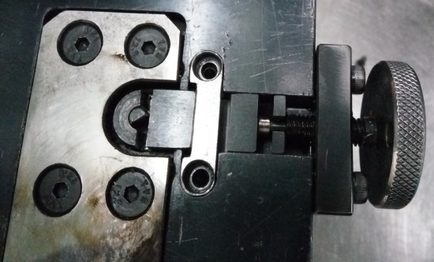
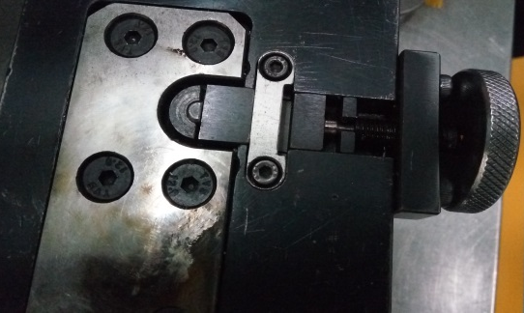
P15
TPM CIRCLE NO :- 01
ACTIVITY
KK
QM
PM
JH
SHE
OT
DM
E&T
KAIZEN IDEA SHEET
TPM CIRCLE NAME:
LOSS NO. / STEP
DEPT :- ASSEMBLY
RESULT AREA
P
Q
A
C
D
S
M
CELL:- D comp
CELL NAME:- A325 Cam Assly.
MACHINE / STAGE :- Assembly
OPERATION :- Assly.
KAIZEN THEME : To eliminate the C.C of the cam angle zero.
IDEA :- Gap between roller mounting edge & clamping block to be reduced by reversing the stopper plate
Problem present status :- Excess gap between roller mounting edge & clamping block.
COUNTERMEASURE:-
1) Gap between roller mounting edge & clamping block to be reduced (Before=5.95mm,After=4.10mm) by reversing the stopper plate & removing plate material by 0.7mm)
BENCHMARK
398
TARGET
0
KAIZEN START
10.08.2016
TDC
2.09.2016
TEAM MEMBERS : Mohan Kate, Nitin Sutar
,Supriya Patil
KAIZEN FINISH
4.09.2016
BENEFITS :-
No chances of generation of cam angle zero.
Before
KAIZEN SUSTENANCE
After
WHY - WHY ANALYSIS :-
Why1 :- Cam angle found zero.
Why2 :- Roller getting tilt while roller clamping.
Why3 :- Excess gap between roller mounting edge & clamping block.
Why4 :- Weak Fixture design.
WHAT TO DO:-.Point added in fixture validation sheet
HOW TO DO:- Gap checking by DVC.
FREQUENCY :- 3 months
RESULT :-
ROOT CAUSE : Weak fixture design.
REGISTRATION NO. & DATE :- 10.08.16
SCOPE & PLAN FOR HORIZONTAL DEPLOYMENT
REGISTERED BY :- Mohan Kate
SR.
NO.
CELL
TARGET
RESPONSIBILITY
STATUS
MANAGER’S SIGN: Janardan sathe
1
A394
23.09.16
Nitin Sutar
Completed

